Slide 1



Impact of Sleep on Physical
and Mental Health
PRESENTED BY
TEAM: EWOK

Slide 2


Introduction
Sleep plays a crucial role in maintaining overall health and well-being, especially for students. However, irregular sleep schedules are becoming increasingly common among adolescents and young adults due to academic pressures, social activities, and the widespread use of electronic devices.
This presentation explores the impact of irregular sleep schedules on students’ mental health, academic performance, and daily mood.

Slide 3



Research Question:
What is the impact of irregular sleep schedules on students' mental health, academic performance, and mood during the day?
Hypothesis:
Irregular sleep patterns contribute to increased levels of stress, anxiety, and mood swings among students. These negative effects can lead to poor academic outcomes, behavioral challenges, and diminished overall well-being.
By analyzing these factors, we aim to highlight the importance of maintaining consistent and adequate sleep schedules to support students' success and mental health.

Slide 4




Objective
The objective of this study is to understand the profound impact of irregular sleep schedules on students' mental health, academic performance, and mood. By identifying the challenges posed by insufficient and inconsistent sleep patterns, the aim is to:
Raise
Awareness
Provide Evidence
Recommend Solutions
Encourage Intervention

Slide 5

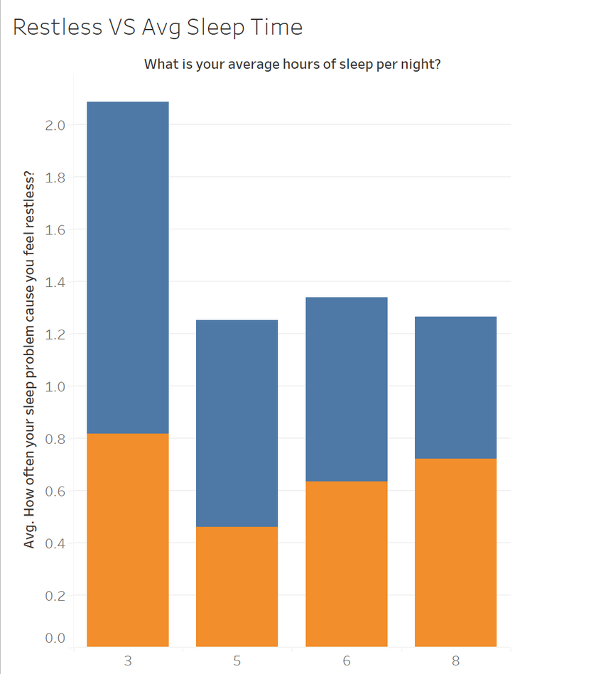
Restless vs. Average Sleep Time:
The frequency of feeling restless decreases as the average sleep time increases.

Slide 6
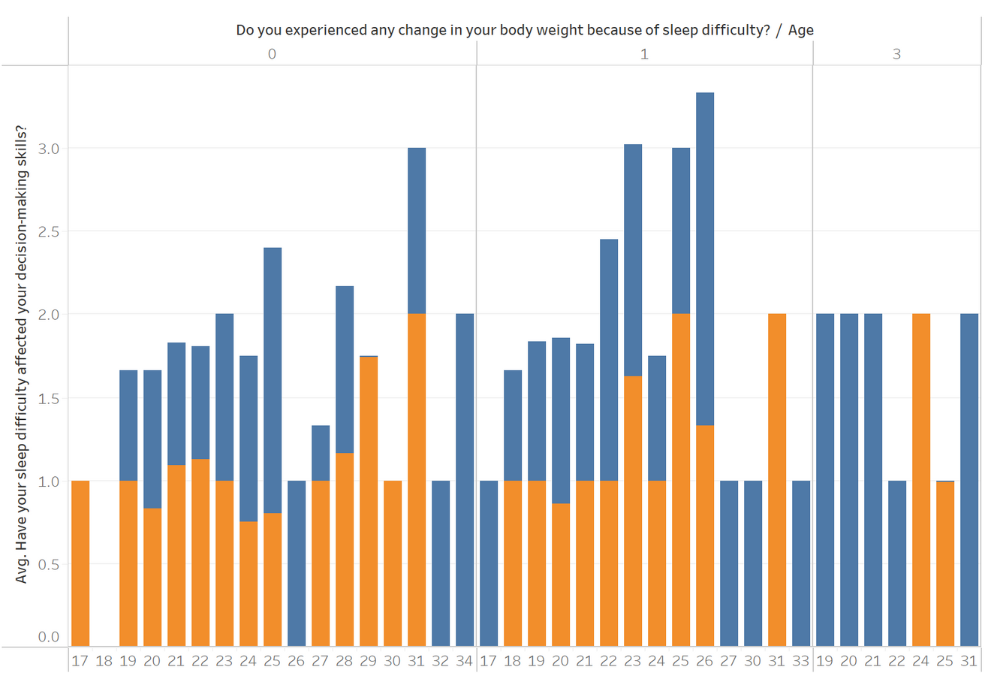
Sleep Difficulty and Decision-Making:
Sleep difficulties significantly impact decision-making abilities, with variations across age and weight changes.

Slide 7
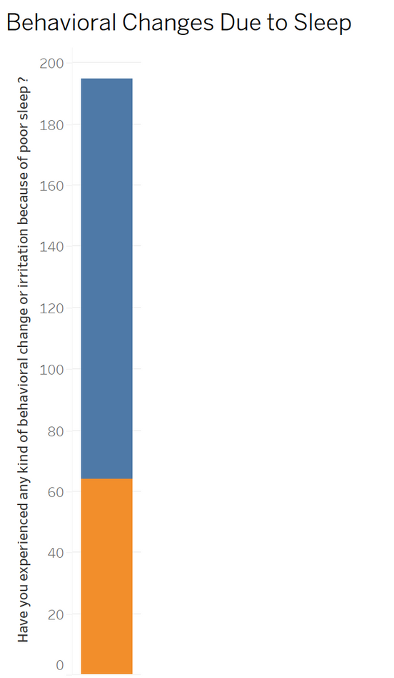
Behavioral Changes Due to Sleep:
Poor sleep often results in increased behavioral changes, such as irritation and mood swings.

Slide 8
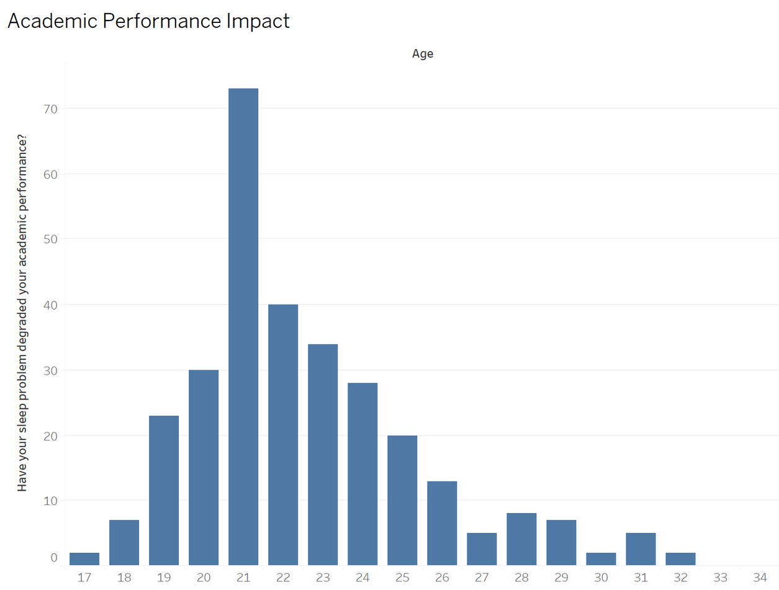
Academic Performance Impact:
Sleep problems are most prominent in degrading academic performance among students aged 20-22.

Slide 9
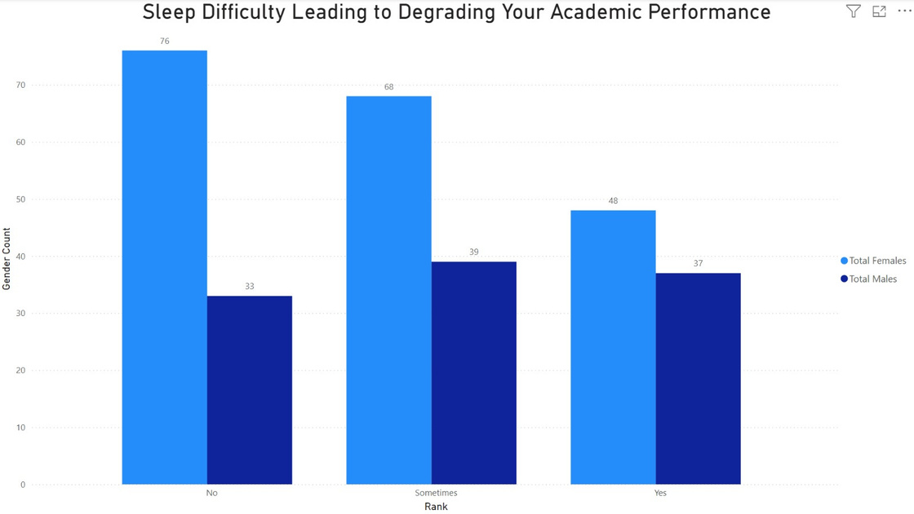
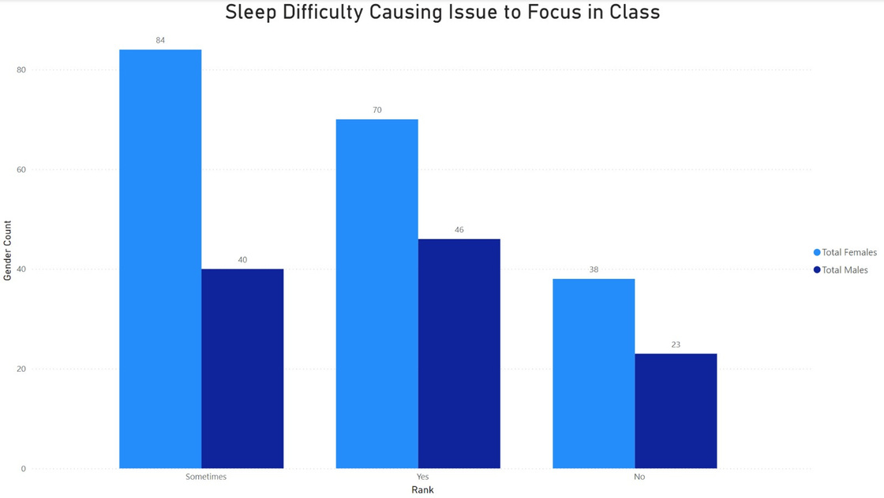
Academics
Academic Performance:
Focus Issues in Class:
Sleep difficulties degrade academic performance significantly, with females slightly more affected than males.
Sleep issues sometimes or frequently disrupt focus in class, with females reporting more frequent disturbances than males.

Slide 10
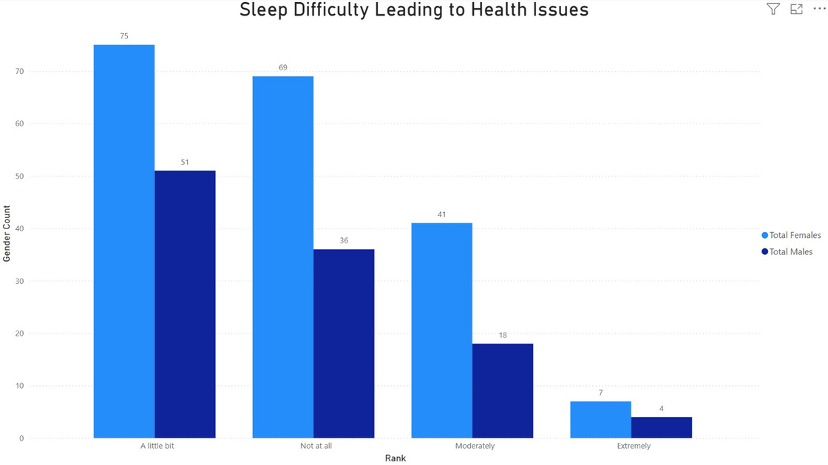
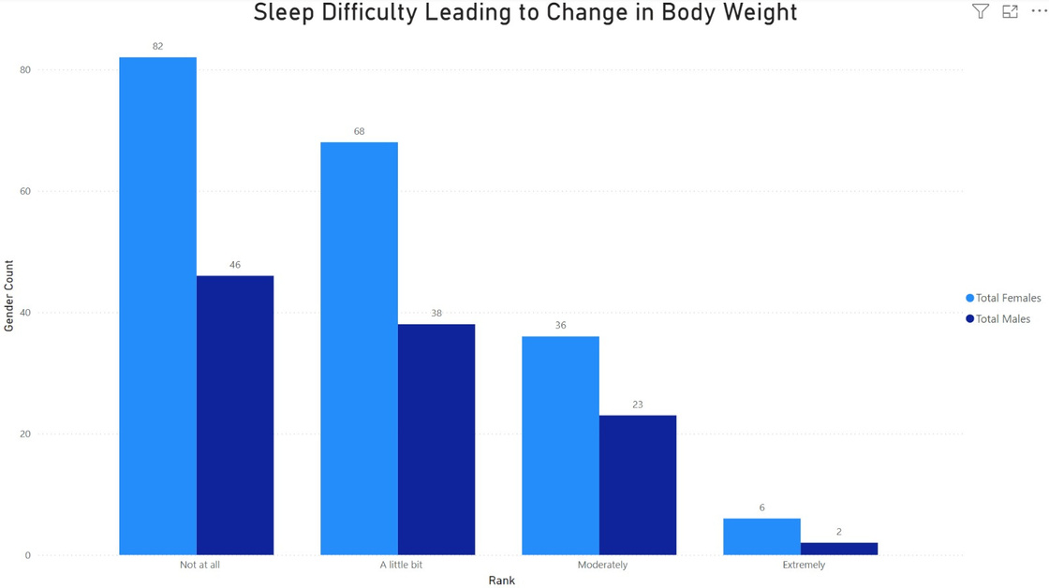
Health
Health Issues:
Body Weight:
Sleep difficulties lead to health problems, with a notable percentage reporting mild to moderate effects.
Changes in body weight are linked to sleep difficulties, affecting females more prominently than males

Slide 11
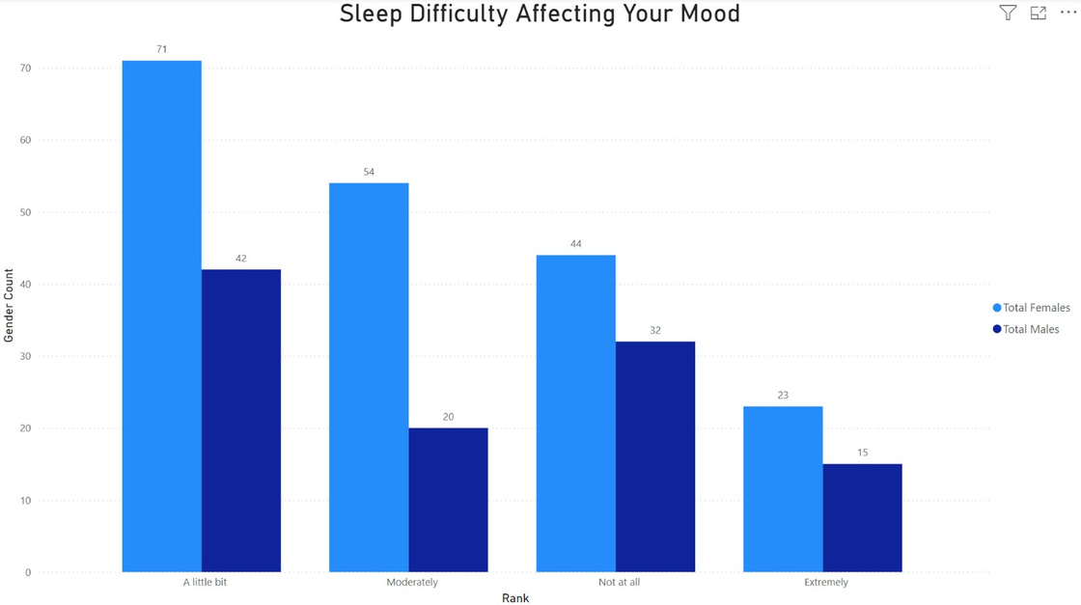
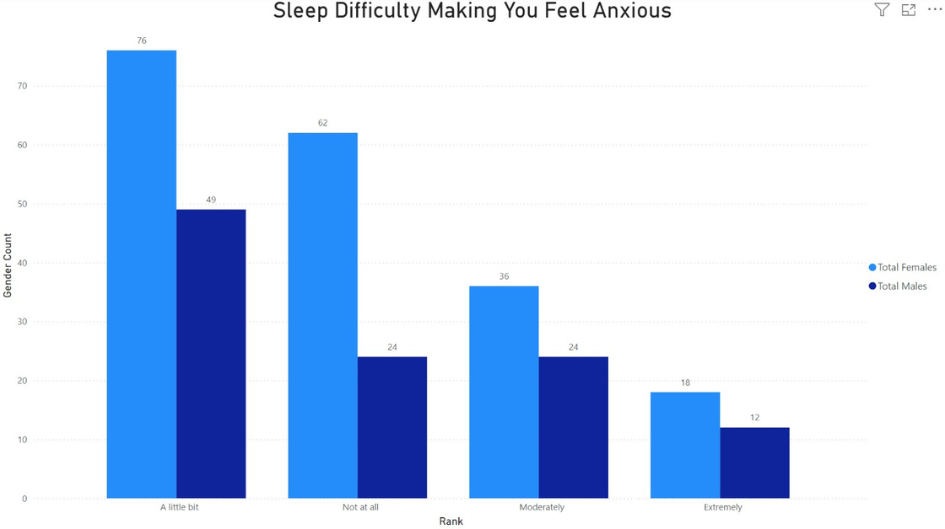
Daily Performance
Mood:
Anxious Feelings:
Sleep difficulties heavily impact mood, with females reporting more mood-related disruptions
Poor sleep contributes to anxiety, with females experiencing slightly higher levels than males.

Slide 12
Primary Data
Anxity:

Slide 13
Primary Data
Mood:

Slide 14

Analysis
Mental Health:
Academic Performance:
Irregular sleep increases anxiety, irritability, and emotional instability.
Poor sleep hinders focus, memory retention, and cognitive abilities, leading to academic decline.
Behavioral Impact:
Physical Health:
Mood swings and reduced motivation are common among students with sleep difficulties.
Consistent sleep patterns are crucial for enhancing mental, academic, and physical well-being..

Slide 15

Result
Students with shorter sleep durations experienced higher levels of restlessness, affecting mental stability.
Sleep difficulties impaired decision-making abilities, particularly in those with weight changes due to poor sleep.
Poor sleep led to behavioral changes, such as irritability and mood swings.
Academic performance declined most significantly among students aged 20-22, impacting focus and learning outcomes.
Adequate sleep is essential for maintaining mental health, academic success, and emotional balance.

Slide 16

Conclusion
Irregular sleep schedules have a profound impact on students’ mental health, academic performance, and emotional stability.
Poor sleep leads to increased restlessness, impaired decision-making, behavioral changes, and academic challenges.
Students aged 20-22 are particularly vulnerable to the adverse effects of sleep deprivation on academic success.
Prioritizing consistent and adequate sleep is essential for improving cognitive function, reducing stress, and enhancing overall well-being.
Institutions and individuals must work together to promote healthy sleep habits to support student success and mental health.

Slide 17
A
Q
Q
A
AND

Slide 18



THANK
YOU

